Slide 1

Azure EventGrid
Global Azure bootcamp 2018 Sean Feldman
Feldman.sean@gmail.com

Slide 2




Messaging solutions

Slide 3
Why EventGrid?
Build applications with event-based architecture (pub/sub)
Reactive programming
Support for Azure resources events and custom events

Slide 4
Concepts
Events - What happened.
Event sources/publishers - Where the event took place.
Topics - The endpoint where publishers send events.
Event subscriptions - The endpoint or built-in mechanism to route events, sometimes to multiple handlers. Subscriptions are also used to filter incoming events.
Event handlers - The application or service reacting to the event.

Slide 5
Capabilities
Simplicity - Point and click to aim events from your Azure resource to any event handler or endpoint.
Advanced filtering - Filter on event type or event publish path to ensure event handlers only receive relevant events.
Fan-out - Subscribe multiple endpoints to the same event to send copies of the event to as many places as needed.
Reliability - Utilize 24-hour retry with exponential back-off to ensure events are delivered.
Pay-per-event - Pay only for the amount you use EventGrid.
High throughput - Build high-volume workloads on EventGrid with support for millions of events per second.
Built-in Events - Get up and running quickly with resource-defined built-in events.
Custom Events - use EventGrid route, filter, and reliably deliver custom events in your app.

Slide 6
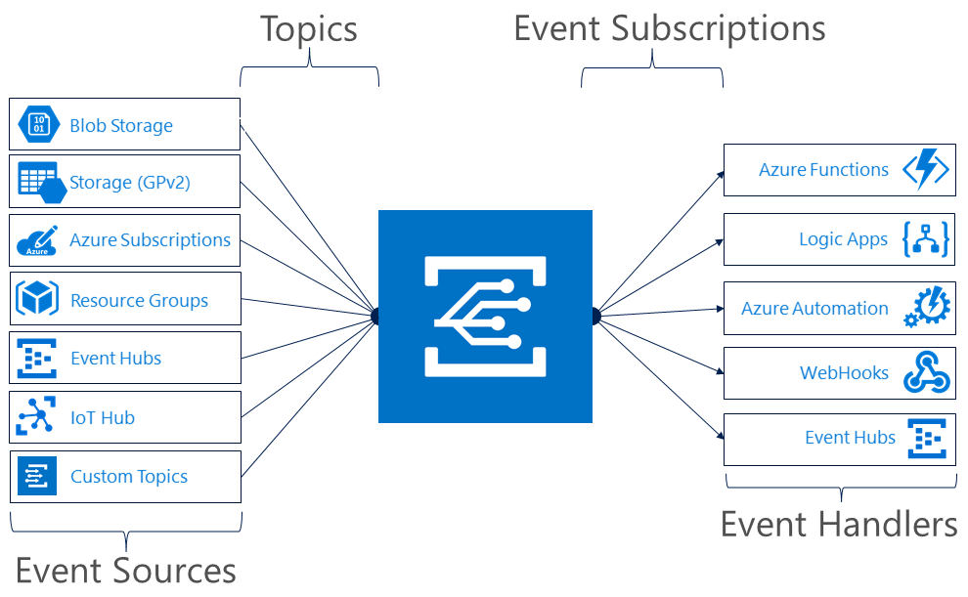
Supported Scenarios

Slide 7
When things go wrong
10 seconds
30 seconds
1 minute
5 minutes
10 minutes
30 minutes
1 hour
After one hour, event delivery is retried once an hour for up-to 24 hours

Slide 8
Is there life after 24 hours?
No.
But scientists are working on it.

Slide 9
Event schema
[
{
"topic": string,
"subject": string,
"id": string,
"eventType": string,
"eventTime": string,
"data":{
object-unique-to-each-publisher
},
"dataVersion": string,
"metadataVersion": string
}
]

Slide 10
Event Types: IoT Hub
Event type | Description
Microsoft.Devices.DeviceCreated | Published when a device is registered to an IoT hub.
Microsoft.Devices.DeviceDeleted | Published when a device is deleted from an IoT hub.

Slide 11
Building Device Notifications
Event Grid, functions, Managed service identity, Eventgrid, twilio, and a few more buzzwords

Slide 12






Objective

Slide 13
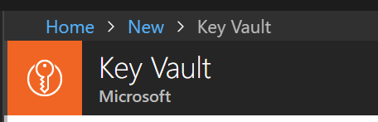
Step 1 – Create Key Vault

Slide 14
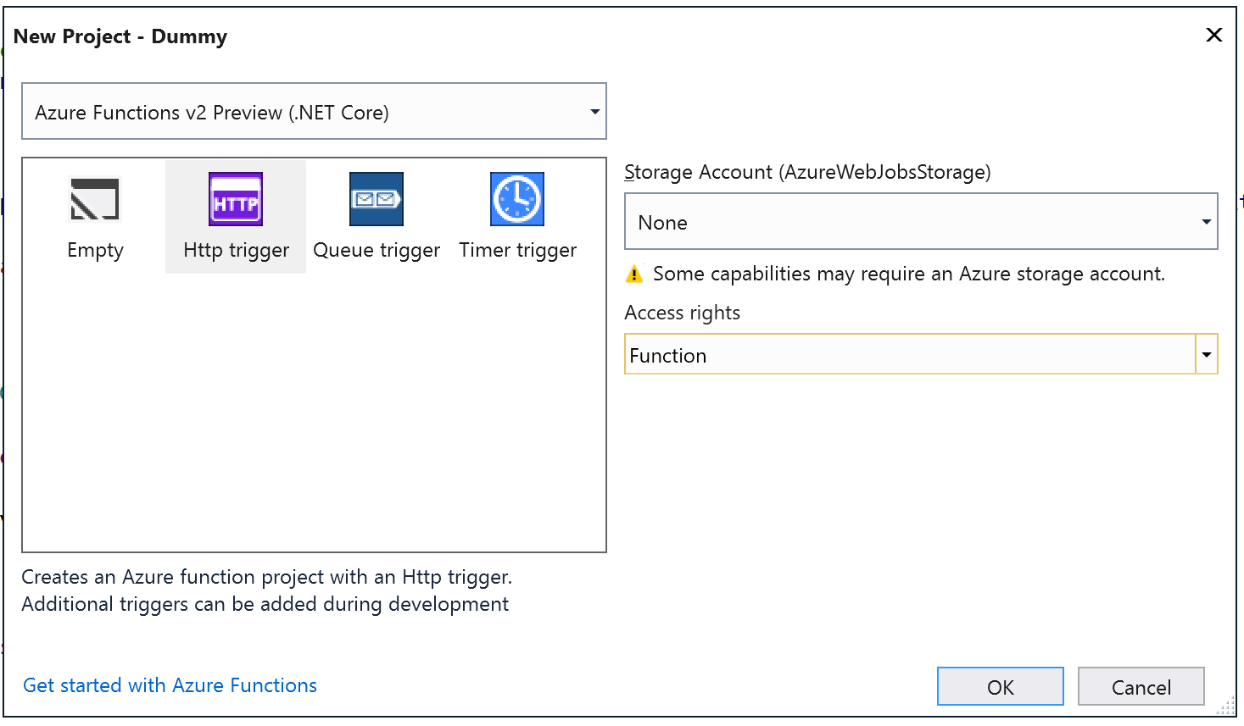
Step 2 – Create and Deploy a Function
HTTP Triggered Function
Version 2 (preview) / .NET Core

Slide 15
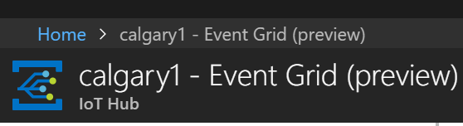
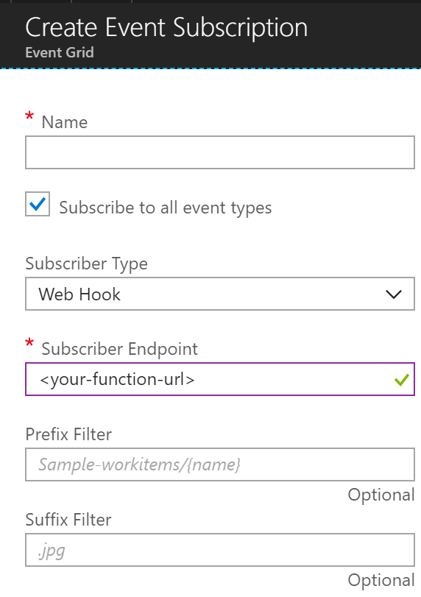
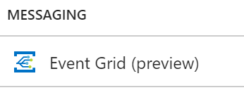

Step 3 – EventGrid Subscription for IoT Hub

Slide 16
Step 4 – EventGrid Authentication
log.Info("C# HTTP trigger function received a request.");
var requestBody = await new StreamReader(req.Body).ReadToEndAsync();
var events = EventGridEvent.DeserializeEventGrid(requestBody);
if (events.Length == 1 && events[0].EventType == "Microsoft.EventGrid.SubscriptionValidationEvent")
{
var validationCode = (string)((JObject)events[0].Data)["validationCode"];
return new JsonResult(new { validationResponse = validationCode });
}

Slide 17
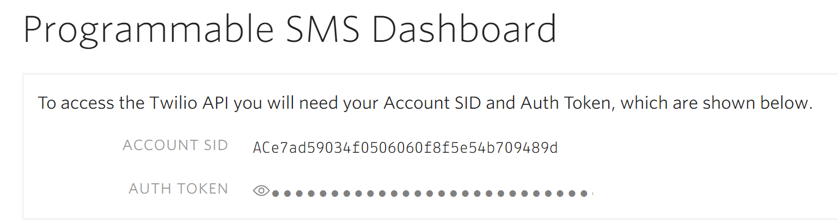
Step 5a – Register with Twilio / SendGrid
Get a phone number to send SMSes
Twilio → Phone Numbers → Manage Numbers
Write down SMS API Credentials
Twilio → Programmable SMS Dashboard → Show API Credentials

Slide 18
Step 5b –Twilio Settings for Function
class TwilioSettings
{
public string AccountSid { get; set; } // SMS API Credentials
public string AuthToken { get; set; } // SMS API Credentials
public string To { get; set; } // your cell number
public string From { get; set; } // your Twilio number
public static TwilioSettings DeserializeTwilioSettings(string payload)
{
return JsonConvert.DeserializeObject<TwilioSettings>(payload, new JsonSerializerSettings
{ ContractResolver = new CamelCasePropertyNamesContractResolver() });
}
}

Slide 19
Step 6, 7, 8, 9 – Security (aka Fun Part)
KeyVault: Access Policies → Add Access Policy → Select Principle → <function name> → Secret Permissions → Get
KeyVault secret value: { accountSid: “<sid>", authToken: “<token>", to: “<to>", from: “<from>" }
Enabling MSI: Functions App → Platform Features → Managed Service Identity → Register with AAD: On
Required packages:
<PackageReference Include="Twilio" Version="5.*" />
<PackageReference Include="Microsoft.Azure.Services.AppAuthentication" Version="1.1.0-*" />
<PackageReference Include="Microsoft.Azure.KeyVault" Version="2.3.2" />
KeyVault URL: Function App → Application Settings → Add new setting
key: twilio-secret
value: <keyvault-secret-url>
Why Sean, oh why?!
Because
Security Matters ™

Slide 20
Step 10a - Retrieving Twilio Credentials
static readonly HttpClient client = new HttpClient();
var azureServiceTokenProvider = new AzureServiceTokenProvider();
var kvClient = new KeyVaultClient(
new KeyVaultClient.AuthenticationCallback(azureServiceTokenProvider.KeyVaultTokenCallback), client);
var secretUri = Environment.GetEnvironmentVariable("twilio-secret");
var twilioSettings = (await kvClient.GetSecretAsync(secretUri)).Value;
var settings = TwilioSettings.DeserializeTwilioSettings(twilioSettings);

Slide 21
Step 10b – Mapping Twilio Credentials
var accountSid = settings.AccountSid;
var authToken = settings.AuthToken;
var to = new PhoneNumber(settings.To);
var from = new PhoneNumber(settings.From);

Slide 22
Step 11 - Handling EventGrid Messages
var twilioClient = new TwilioRestClient(accountSid, authToken);
foreach (var @event in events)
{
var deviceId = ((JObject) @event.Data)["deviceId"];
var deviceStatus = ((JObject) @event.Data)["opType"].ToString().Replace("Device", string.Empty);
var hub = ((JObject) @event.Data)["hubName"];
var message = await MessageResource.CreateAsync(to: to, from: from,
body: $"Device ID: {deviceId} was {deviceStatus} (hub: {hub})",
client: twilioClient);
}

Slide 23
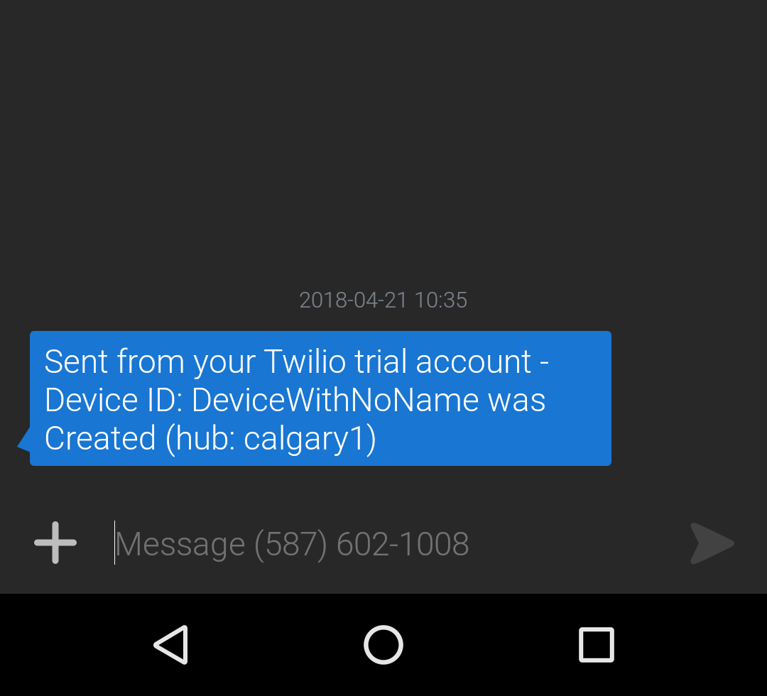
Et Voilà!

Slide 24
http://bit.ly/dotnetcalgary
Calgary .NET UG/Meetup slack

